Slide 1


An Optimized Model Using AHP-VIKOR in the Web-Service Based E-Learning
School Of Education Technology
Jadavpur University, Kolkata-700032
M. Tech Thesis Presentation
Supervisor
Mr. Joydeep Mukherjee
Presented By
Avirup Saha
Class Roll No.: 002030402005
Examination Roll No.: M4CWE22005
University Registration Roll No.: 154487 of 2020-21
E-Learning Model
Date: 05.07.2022

Slide 2
Outline of the presentation
Introduction
Literature Survey
Proposed Approaches
Experimentation and Results
Comparative Analysis
Conclusion and Future Scopes
References

Slide 3
Introduction
E-learning[1] is experiencing a surge in Information and Communication Technologies (ICT)[2]. As a result, web-based E-Learning systems[3] are being groomed for growth, even though poor content and design difficulties prohibit this.
To optimize its utilization, important elements must be considered so the Multiple-criteria decision making(MCDM)[4] approaches were used to identify and prioritize the elements. Among these MCDM methods, AHP-VIKOR[5] is the most optimized for this situation.
Structural Equation Modeling (SEM)[6] was used to create a positive optimized Web-based E-Learning system.
As a learning methodology, the Successive Approximation Model (SAM)[7] should be adapted over the ADDIE model[8].
ISO/IEC 27001:2013[9] is ideal for this particular domain.

Slide 4
Introduction(contd.)
Problem Statement: Factors that are responsible for obtaining the optimization are not being considered properly. To eradicate this imbalance, MCDM approaches[4] and other proposed approaches are applied to obtain the most optimized e-learning model.
Objectives: The objectives of this thesis paper are to lessen the incompetency of some approaches that have been implemented over the past. The factors which can be manipulated to enhance quality will be identified and by applying prioritised ranking approaches inefficiencies will be reduced in this study.
Motivation: AHP[10] was used in this domain previously and Fuzzy AHP, Fuzzy TOPSIS[1] were for kept as future exploration. This was the trigger for motivation which created a room for more optimized version.

Slide 5
Literature Survey
Franklin[11] proposed several criteria mathematical approaches and De Condorcet[3] improved it. Ramsey suggested about decision-making axioms.
Esogbue et al.[12] applied fuzzy set methodologies to sort out the real-world problems and Balmat shared a classical set theory extension that deals with inconsistent data which is Fuzzy set theory.
Thomas L. Saaty[11] shared a method for organizing and analysing complex decisions, using math and psychology which is known as Analytical Hierarchical Process[4]. Belton and Gear improved and created Modified AHP (RAHP)[13] and again this got changed into Ideal Mode AHP or BG-AHP[13] which was supported by Saaty.
Moreno-Jime ́nez et al. [1] applied AHP in larger scale to obtain proper decision for identifying the weight ratios among strategic factors.
Qin et al.[14] suggested that TOPSIS is a methodology that is used in multi-dimensional computing space for achieving that alternative which is closer to ideal and farther from negative ideal solution.

Slide 6
Literature Survey(contd.)
For achieving the best alternatives Dursun’s study[15] focuses on the fuzzy VIKOR approach however fuzzy VIKOR has a drawback in that it only has one level of criteria for alternatives and no integration with AHP whereas three levels of alternatives are allowed for AHP and VIKOR.
Rawashdeh et al.[13] shared that VIKOR is now widely used to solve MCDM problems in a variety of sectors, including environmental policy, data envelopment analysis and employee training selection.
Mahahusudhan and Eze et al.[16] confirmed that Web based learning system promotes the relationship between instructors and students.
Taha et al.[6] suggested the ambiance of the classroom to be provided by the home environment.
Akyüz & Samsa[6] said to consider Course content which should be appropriate for learning purposes. By using a Structural Equation Modelling (SEM) approach[6] positive relationship among the quality of e-learning, independent variables & moderating variables can be explored.
Branson[17] coined the term “ADDIE” and Russell Watson refined it. Hannum[6] identified the important complement of the model to the development of educational and training programs.

Slide 7
Literature Survey(contd.)
Michael Molenda[18] confirmed that ADDIE Model is merely a colloquial moniker for a systematic approach to instructional development that is almost interchangeable with instructional systems development (ISD)
Morrison et al.[19] implemented conventional e-learning materials using the ADDIE paradigm however Kruse[18] criticised as ADDIE model is excessively linear, rigid, constricting and time-consuming to apply for implementation.
Allen & Sites[20] showed interest to build quick and meaningful design and develop learner-friendly E-learning content using SAM.
ISO/IEC 9126-1[9] was part of Web Quality Model (WQM)[1]model which was proposed by Vida and Jons. Wang et al. proposed standard ISO/IEC 27001:2013[21] for this domain.
Abdul et al. proposed that the SERVQUAL methodology[1] is designed to assess the difference between consumers’ expectations and their actual user experience.
[1] Muhammad, Abdul Hafeez and Siddique, Ansar and Youssef, Ahmed E and Saleem, Kashif and Shahzad, Basit and Akram, Adnan and Al-Thnian, Al-Batool Saleh. “A hierarchical model to evaluate the quality of web-based e-learning systems”. In: Sustainability 12.10 (2020), p. 4071.
[9] Bee Bee Chua and Laurel Evelyn Dyson. “Applying the ISO 9126 model to the evaluation of an e-learning system”. In: Proc. of ASCILITE. Vol. 5. 8. 2004, pp. 184–190.
[18] Michael Molenda. “In search of the elusive ADDIE model”. In: Performance improvement 54.2 (2015), pp. 40–42.
[19] Clement Ayarebilla Ali, Saknah Acquah, and Kweku Esia-Donkoh. “A Comparative Study of SAM and ADDIE Models in Simulating STEM Instruction.” In: African Educational Research Journal 9.4 (2021), pp. 852–859.
[20] Jung, Hyojung and Kim, Younglong and Lee, Hyejeong and Shin, Yoonhee“Advanced instructional design for successive E-learning: Based on the successive approximation model (SAM)”. In: International Journal on E-learning 18.2 (2019), pp. 191–204.
[21] Hsu, C., Wang, T., & Lu, A. (2016, January). The impact of ISO 27001 certification on firm performance. In 2016 49th Hawaii International Conference on System Sciences (HICSS) (pp. 4842-4848). IEEE.

Slide 8
Proposed Approaches
The study is based on the e-learning and main motive is to maintain the highest quality factor so data set is taken based on quantity, demography and other aspects also.
AHP-VIKOR[5] is to be chosen as MCDM approach to calculate the final criteria and sub-criteria for determining the preference with high accuracy for building E-learning model.
AHP[10] is effective by preserving the relative weight or relevance of the data set while removing some of the criteria to retain the quality of the model that will be deployed.
The VIKOR[22] technique presents a compromise solution with an advantage rate in addition to ranking
So Hybridization of AHP and VIKOR which is AHP-VIKOR[23] shares most optimum result with most import criteria and sub-criteria that to be decided.
[5] Nayebi, Mohammad Amin and Tavassolian, Seyyed Ali and Ebrahimi, Mohammad Ali and Asadollahi, Amin “Application of the VIKOR-AHP model in VSP”. In: Archives Des Sciences 65.4 (2012), pp. 85–101.
[10] R Karthikeyan, KGS Venkatesan, and A Chandrasekar. “A comparison ofstrengths and weaknesses for analytical hierarchy process”. In: Journal of Chemical and Pharmaceutical Sciences 9.3 (2016), pp. 12–15[2] Nishrin Pathan. “Integration of Information & Communication Technologies (ICT) by SMEs in India”. In: SEMCOM Management & Technology Review (2014), p. 104.
[22] Morteza Yazdani and Felipe R Graeml. “VIKOR and its applications: A state-of-the-art survey”. In: International Journal of Strategic Decision Sciences (IJSDS) 5.2 (2014), pp. 56–83
[23] Reza Ghezelbash and Abbas Maghsoudi. “A hybrid AHP-VIKOR approach for prospectivity modeling of porphyry Cu deposits in the Varzaghan District, NW Iran”. In: Arabian Journal of Geosciences 11.11 (2018), pp. 1–15.

Slide 9
Proposed Approaches(contd.)
WHY TOPSIS & FUZZY AHP MODEL ARE DISCARDED?
1) TOPSIS[14] encompasses vector normalizing and this vector normalised value for a particular criterion may vary depending on the assessment unit, which is troublesome for this study.
2) TOPSIS utilizes n-dimensional Euclidean distance, which on its own may indicate an equilibrium between overall and individualised commitment but in a different way from VIKOR, which uses weight(Maximum utility factor).The VIKOR approach[22] offers a middle-ground option that includes an advantage rate in addition to ranking. Because the goal of the study is to give which will be near to optimal solution for getting maximum efficacy so the VIKOR approach is recommended above the TOPSIS method.
3) AHP assists decision-makers in choosing between options and Fuzzy logic is an approach for dealing with ambiguous data and imprecise information. The Fuzzy AHP[1] can be preferred by decision-makers whenever they need to make a decision under ambiguous scenarios. In this study the main criteria and sub-criteria are explicitly indicated and the conclusion will not be made under uncertain circumstances so the Fuzzy-AHP approach is excluded. As the same fuzzy logic exists in the Fuzzy TOPSIS so it is also removed from the list.
[1] Muhammad, Abdul Hafeez and Siddique, Ansar and Youssef, Ahmed E and Saleem, Kashif and Shahzad, Basit and Akram, Adnan and Al-Thnian, Al-Batool Saleh. “A hierarchical model to evaluate the quality of web-based e-learning systems”. In: Sustainability 12.10 (2020), p. 4071.
[14] Fatih and SARI. “Comparison of TOPSIS and VIKOR multi criteria decision analysis techniques”. In: Selçuk Üniversitesi Mühendislik, Bilim Ve Teknoloji Dergisi 6 (2018), pp. 825–831
[22] Morteza Yazdani and Felipe R Graeml. “VIKOR and its applications: A state-of-the-art survey”. In: International Journal of Strategic Decision Sciences (IJSDS) 5.2 (2014), pp. 56–83

Slide 10
Proposed Approaches(contd.)
Wang et al. proposed standard ISO/IEC 27001:2013[21] for designing E-Learning Model.
Machine learning[24] based proctored test, customized LMS and 24X7 help desk are the factors that can lead to best E-Learning model establishment. OS independent LMS, progress-tracker and other aspects can build a proper E-Learning Mode.
Gamification[25] of E-Learning course is always compelling for the learner. It is the most effective and powerful method of motivating students.
Certification[26] on the completion of the course motivates the student and such reward after completing courses has some benefits also and showcasing certification for future use is also beneficial.
Design of eLearning tool with an eccentric design, eye-catching logo, creative representation with robust back end technology always have potential to gain more learner.
Individual accomplishment, report cards, course advancement and training histories potentially improve instructional strategies for individuals and comparable developing learners can utilize the flexible LMS[36] to share the same course design, as well as other study materials
[21] Hsu, C., Wang, T., & Lu, A. (2016, January). The impact of ISO 27001 certification on firm performance. In 2016 49th Hawaii International Conference on System Sciences (HICSS) (pp. 4842-4848). IEEE.
[22] Morteza Yazdani and Felipe R Graeml. “VIKOR and its applications: A state-of-the-art survey”. In: International Journal of Strategic Decision Sciences (IJSDS) 5.2 (2014), pp. 56–83
[24] Oztekin, Asil and Delen, Dursun and Turkyilmaz, Ali and Zaim, Selim “A machine learning-based usability evaluation method for eLearning systems”. In: Decision Support Systems 56 (2013), pp. 63–73
[25] Mariya Gachkova, Elena Somova, and Silvia Gaftandzhieva. “Gamification of courses in the e-learning environment”. In: IOP conference series: Materials science and engineering. Vol. 878. 1. IOP Publishing. 2020, p. 012035
[26] Thaddeus FitzPatrick. “Key Success Factors of eLearning in Education: A Professional Development Model to Evaluate and Support eLearning.” In: Online Submission (2012).

Slide 11
Proposed Approaches(contd.)
Testing after deployment and after several checks it can be known if the output is optimized or not and precaution measurement and practice of live sessions to do better at the time of lecturing can give a better solution.
Media that are used and all applications are working perfectly or not after deployment to be checked thoroughly.
Initially enormous tests to be done to get better results also. Try and error method can be tedious but helpful and can provide optimized solution to achieve goal.
Track of courses that to be improved or changes in content for syllabus to be done for optimization. LMS with reports can be useful for updating data in a shorter time frame; otherwise, it might be stressful and disrupt the learner’s schedule.
If students miss any live session, they will be shared classes via mail also and further doubt classes to be scheduled so that no individual face issue while going through any topic. Mails regarding other new important courses can also help learners to track all important course schedules accordingly.

Slide 12
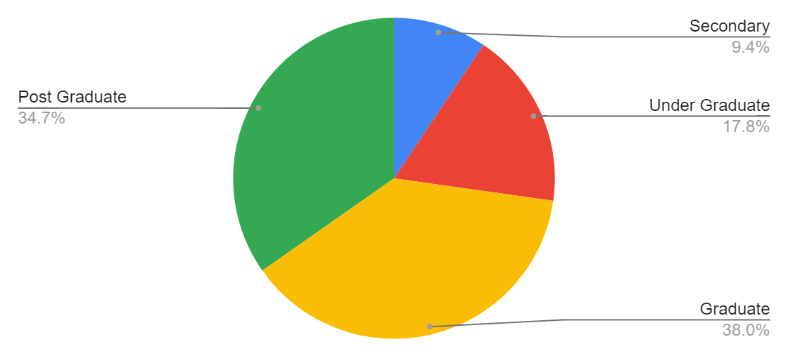
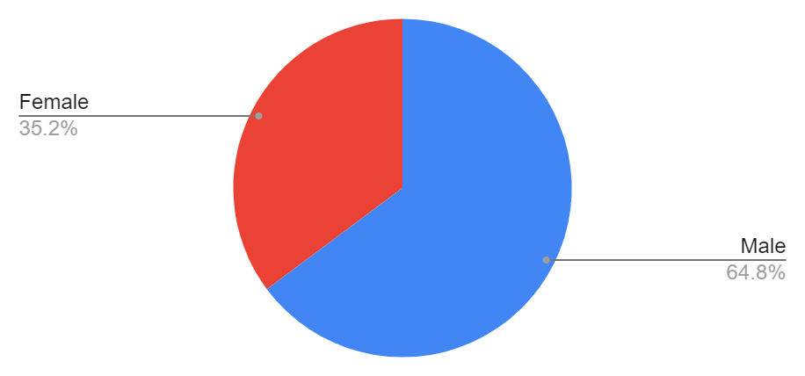
Experimentation and Results
In the first phase, a literature survey was taken using Google-form where 213 responses were captured and each individual shared only one response so all the data are kept intact for future use. None of the data were discarded for being incomplete, vague and inconsistent.
Among them 138(64.8%) were Male candidates and 75(35.2%) were Female candidates.
Main 4 types of candidates: Secondary, Under Graduate, Graduate and Post Graduate shared their view for selecting the criteria and sub-criteria

Slide 13
Experimentation and Results(contd.)
All sub-criteria are: Timely, Relevant, Multilingual, Variety of Presentation, Accuracy, Reliability of content, Attractiveness, Appropriateness, Color, Multimedia Elements, Text, Browser Compatibility, Index, Navigation, Consistency, Links, Logo, Domain, User Friendly, Reliability of Usability, Availability & Interactive Features.
These are distributed in 5 types importance level. These are: Most Important, Important, Less Important, Neutral and Not Important.

Slide 14
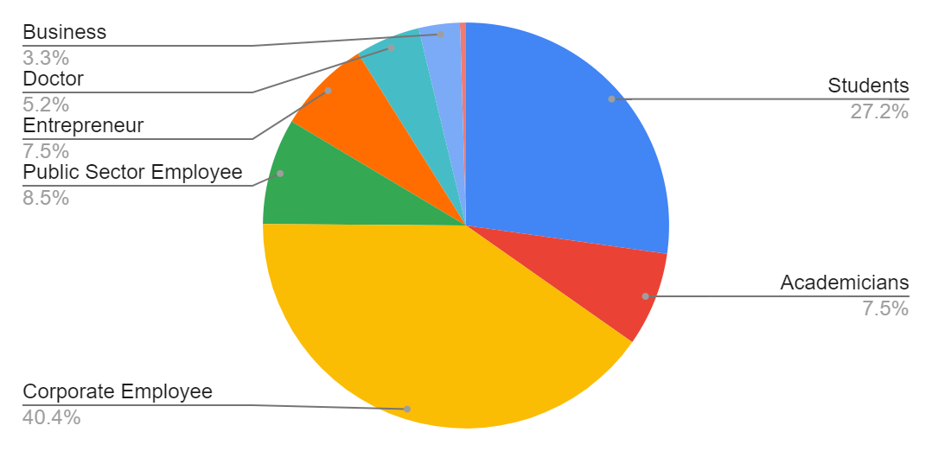
Experimentation and Results(contd.)
The demographic profile of the respondents are 58 students, 16 Academicians participated, 86 Corporate Employees, 16 Public sector employees,11 Doctors, 7 Business Man, 16 Entrepreneurs and 1 Investment Banker were part of this survey.
The average mean is 3.63.
Maximum mean was 3.85 and minimum was 3.47. Mean above 3.63 are accepted sub-criteria.
Sub-Criteria | Mean
Reliability of content | 3.85
Relevance of the content | 3.83
Timely of content | 3.74
Accuracy of content | 3.73
Reliability of usabilty | 3.71
User friendly of usabilty | 3.70
Interactive features of usabilty | 3.67
Appropriateness of designing | 3.64

Slide 15
Experimentation and Results(contd.)
METHODOLOGY: AHP, VIKOR and AHP-VIKOR method to applied.
AHP: Relative importance of different attributes to be shared. In this study five options More Important, Important, Neutral, Less Important and Not Important are given weightage of 5, 4, 3, 2 & 1 respectively. After that A pair-wise comparison matrix is created and normalization is calculated on that. Once normalization done λ_{max} is calculated. From that value C.I is calculated where C.I = (λ_{max} − n)/(n − 1). The C.R. value for standard inconsistency is 0.10. If the value of C.R or C.I/RI is less than 0.10 then the matrix is moderately consistent matrix and given rank accordingly.
VIKOR: Weightage Factor is determined using scale of relative importance after that best and worst value is calculated and then a matrix of criteria and different alternatives are determined. Then S_{j},R_{j} and Q_{j} needs to be calculated. Based on Q_{j} the ranking will be provided after consistency is checked using the DQ value. If consistent then the ranking that is applied is correct else needed to be modified.
AHP-VIKOR: Relative importance of different attributes to be shared. In this study five options More Important, Important, Neutral, Less Important and Not Important are given weightage of 0.333, 0.267, 0.200, 0.133 & 0.067 respectively. Then the mean more than average mean are accepted and best and worst value is calculated for them. Afterwards S_{j},R_{j} and Q_{j} is calculated and depending on Q_{j} value the ranking is provided and consistency checked if consistent then it remains else next sub-criteria is provided most important ranking and again it is checked for consistency.

Slide 16
Experimentation and Results(contd.)
Using AHP method:
Overall weights and rankings of criteria and sub-criteria
Factors | Global Weight | Global Weight with Contribution % | Global Ranking of Factors | Sub-Factors | Local Weight | Local Weight with Contribution % | Local Ranking of Sub Factors
CONTENT | 0.255 | 25.55 | 1 | Timely | 0.247 | 24.71 | 3
 |  |  |  | Relevant | 0.253 | 25.29 | 2
 |  |  |  | Accuracy | 0.246 | 24.61 | 4
 |  |  |  | Reliability of Content | 0.254 | 25.39 | 1
DESIGN | 0.247 | 24.68 | 3 | Appropriateness | 1.000 | 100.00 | 1
USABILITY | 0.252 | 25.17 | 2 | User Friendly | 0.334 | 33.40 | 2
 |  |  |  | Reliability | 0.335 | 33.49 | 1
 |  |  |  | Interactive Features | 0.331 | 33.11 | 3

Slide 17
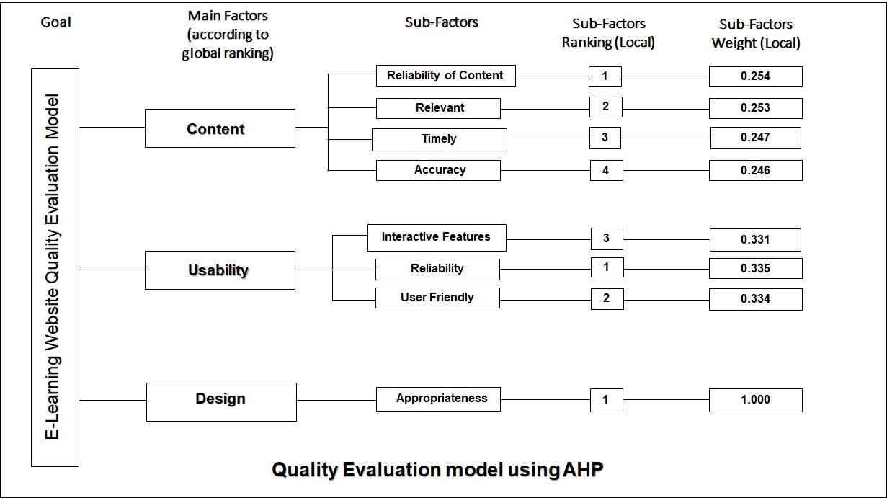
Experimentation and Results(contd.)
Using AHP method:
Criteria | Weighted sum value/criteria weight | Rank
Reliability of Content | 0.1292 | 1
Relevant | 0.1287 | 2
Timely | 0.1257 | 3
Accuracy | 0.1252 | 4
User Friendly | 0.1243 | 5
Interactive Features | 0.1232 | 6
Appropriateness | 0.1222 | 7
Reliability | 0.1216 | 8
The priority order of Main Criteria using AHP method is:
CONTENT > USABILITY > DESIGN

Slide 18
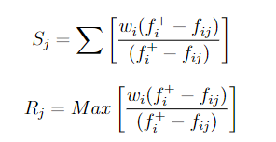

Experimentation and Results(contd.)
Using VIKOR method:
For using this method Sj, Rj, Qj is determined and then checked if Q(a2) − Q(a1) ≥ DQ or not. If it is true then the ranking is kept else alternative process to be followed.
 |  | Very Important | Important | Neutral | Less Important | Not Important
Weightage Factor |  | 0.333 | 0.267 | 0.200 | 0.133 | 0.067
Best (fi+) | 84 | 81 | 59 | 38 | 20
Worst(fi-) | 43 | 57 | 29 | 20 | 7
S⁺= Min(S_{j})
S⁻= Max(S_{j})
R⁺= Min(R_{j})
R⁻= Max(R_{j})
ν= 0.5(Standard)

Slide 19
Experimentation and Results(contd.)
Using VIKOR method:
DQ value is 0.047619048 so the ranking based on the Qj value is consistent.
The priority order of Main Criteria using VIKOR method is:
CONTENT > USABILITY > DESIGN > ORGANIZATION

Slide 20
Experimentation and Results(contd.)
Using AHP-VIKOR method:
First weightage factor is taken like VIKOR method then mean is taken then mean more than average mean are accepted. Among accepted sub-criteria best and worst value is calculated and then using formula of Sj, Rj and Qj is calculated. Then the rank is provided basis on Q value and the consistency is checked. If the matrix is consistent then the ranking is correct else it is altered accordingly.
 | Very Important | Important | Neutral | Less Important | Not Important
Best (fi+) | 84 | 81 | 45 | 38 | 16
Worst(fi-) | 57 | 57 | 29 | 20 | 7
Accepted Sub-Criteria | Sj | Rj | Qj
Reliability of Content | 0.522 | 0.200 | 0.3321
Relevant | 0.504 | 0.126 | 0.0000
Timely | 0.516 | 0.235 | 0.3647
Accuracy | 0.536 | 0.267 | 0.6096
Reliability | 0.529 | 0.200 | 0.3842
User Friendly | 0.564 | 0.244 | 0.7857
Interactive Features | 0.552 | 0.333 | 0.8972
Appropriateness | 0.541 | 0.296 | 0.7166

Slide 21
Experimentation and Results(contd.)
Using AHP-VIKOR method:
Criteria | Sub Criteria | Qj | RANK
CONTENT | Relevant | 0.0000 | 1
CONTENT | Reliability of Content | 0.3321 | 2
CONTENT | Timely | 0.3647 | 3
USABILITY | Reliability | 0.3842 | 4
CONTENT | Accuracy | 0.6096 | 5
DESIGN | Appropriateness | 0.7166 | 6
USABILITY | User Friendly | 0.7857 | 7
USABILITY | Interactive Features | 0.8972 | 8
Content is Rank 1, Usability is Rank 2 and Last
one is Design. Other main Criteria Organization
was discarded as main criteria as none of the
sub-criteria was able to surpass the average mean
Priority Order of Main Criteria using AHP-VIKOR Method is: CONTENT > USABILITY > DESIGN

Slide 22
Comparative Analysis
The overall percentage of efficiency is 3.884% using the AHP. The comparison done between obtained and ideal condition.
Sub criteria | Ideal | Obtained | % Variation
Reliability of Content | 10.747 | 12.877 | 19.822
Relevant | 10.708 | 12.830 | 19.822
Timely | 10.458 | 12.531 | 19.822
Accuracy | 10.419 | 12.484 | 19.822
Reliability | 15.786 | 12.421 | -21.314
User Friendly | 15.746 | 12.390 | -21.314
Interactive Features | 15.606 | 12.280 | -21.314
Appropriateness | 10.529 | 12.186 | 15.729

Slide 23
Comparative Analysis(contd.)
The overall percentage of efficiency is 18.58434% using the VIKOR. The comparison done between obtained and ideal condition.
The overall percentage of efficiency is 21.2719% using the AHP-VIKOR. The comparison done between obtained and ideal condition.
Methodology | Accuracy Level
AHP | 3.884
VIKOR | 18.584
AHP-VIKOR | 21.272

Slide 24
Comparative Analysis(contd.)
WHY AHP-VIKOR IS BETTER THAN AHP AND VIKOR METHOD?
ANS: It can be observed that while entering or removing alternatives, there is inconsistency in the position where the data set was previously altered. The data set loses accuracy due to a lack of data regarding criteria and choices or a lack of fixation during paired tests, however this reduction of redundant data set or criteria is useful when working on situations where criterion is dependent on importance. These AHP features aid AHP-VIKOR in generating only the most optimised Main criterion and Sub-criteria. The accuracy lose that happens due to AHP method is recovered by the process VIKOR so the amalgamation of these two methods bring the most optimized ranking method which is fruitful for developing better e-learning model.
VIKOR analysed all of the 22 sub-criteria and AHP-VIKOR used only 8 sub-criteria that was able to outclass the mean value. So maintaining 8 sub criteria is easier in the real world to implement a better e-learning model with better accuracy.
Both VIKOR and AHP-VIKOR have the ranking system based on the Qj values. So lower the Qj value the higher priority it will share.
Sub Criteria | AHP-VIKOR | VIKOR
Reliability of Content | 0.241 | 0.205
Relevant | 0.000 | 0.664
Timely | 0.219 | 0.413
Accuracy | 0.131 | 0.111
Reliability | 0.208 | 0.172
User Friendly | 0.102 | 0.136
Interactive Features | 0.089 | 0.389
Appropriateness | 0.112 | 0.193

Slide 25
Comparative Analysis(contd.)
Lower the value the greater the priority of the sub-criteria and better efficiency of the particular method.
The proposed approach AHP-VIKOR Methodology has shown that it is 29.280% better than the VIKOR methodology.

Slide 26
Conclusion & Future Scopes
From the study it can be concluded that among three Multiple-criteria decision-making (MCDM) methods i.e Analytical hierarchical process (AHP), VIseKriterijumska Optimizacija I Kompromisno Resenje (VIKOR) and Hybridization of AHP and VIKOR (AHP-VIKOR) the proposed MCDM method AHP-VIKOR is the most constructive method implicitly with a significant efficiency value.
Individual advantages of the AHP and VIKOR when combined for one decision-making purpose and after when it is found that it is the accurate method that to be used for this particular domain confirms better performance ability that stands out than other MCDM.
No work is perfect and research for optimizing all the entities, concepts and their implementation is still going on. The proposed method is an improved version of existing models but it can be improved further using future methods that will be invented later or the existing methods (i.e: Case-based Reasoning, Data Envelopment Analysis, PROMETHEE etc.) that are not utilized in this study.

Slide 27
Conclusion & Future Scopes(contd.)
LIMITATIONS
The literature survey was limited due to geographical outreach.
The literature survey that was taken could be deemed unreliable, resulting in incorrect decision-making
The methodologies that are used can have better the approaches in future however due to timeline constraints the most optimized algorithm which is suitable is utilized.
The method AHP-VIKOR has its own drawbacks.

Slide 28
Conclusion & Future Scopes(contd.)
FUTURE SCOPES
Security level is a great concern. Privacy to be kept in case of E-learning.
A hybrid model like AHP-VIKOR other combinations depending on different normalizations can be calculated for this application.
Other models that are not explored can be the alternatives as well. Using them in try and error method the efficiency can be checked and utilized in that manner.
IAHP model[11] can deal with categorical inputs and outputs without any transformation so in AHP-VIKOR model instead of AHP the alternative IAHP can be used with VIKOR as hybridization.
[11] Jablonsky and Josef. “Measuring the efficiency of production units by AHP models”. In: Mathematical and Computer Modeling 46.7-8 (2007), pp. 1091–1098.

Slide 29
Conclusion & Future Scopes(contd.)
FUTURE SCOPES
Taking the literature survey in a broader aspect will provide efficient out-come. A worldwide survey will be useful though some redundant data to be excluded which will be a tedious process.
The comparison of MCDM to be done with explored models of this study for confirming the truthfulness of the data set.
Due to lack of literary support and their transparency, exploration of other methods is beyond the scope so there might be more efficient approach for showcasing a new E-learning model with better productivity.
CONCLUSION
The topic is humongous if we consider all aspects and the scope of the study is also very vast so there is a large amount of chance to give this study a better direction to establish a better optimized Web Service-based model for E-Learning.

Slide 30
Reference
[1] Muhammad, Abdul Hafeez and Siddique, Ansar and Youssef, Ahmed E and Saleem, Kashif and Shahzad, Basit and Akram, Adnan and Al-Thnian, Al-Batool Saleh. “A hierarchical model to evaluate the quality of web-based e-learning systems”. In: Sustainability 12.10 (2020), p. 4071.
[2] Nishrin Pathan. “Integration of Information & Communication Technologies (ICT) by SMEs in India”. In: SEMCOM Management & Technology Review (2014), p. 104.
[3] Touhid Bhuiyan et al. “Development of a Web-Based E-Learning System for Teaching Institution”. In: 3rd International Conference on Intelligent Computational Systems, Singapore. 2013.
[4] A Jahan, KL Edwards, and M Bahraminasab. “Multi-criteria decision-making for materials selection”. In: Multi-criteria decision analysis for supporting the selection of engineering materials in product design (2016), pp. 63–80
[5] Nayebi, Mohammad Amin and Tavassolian, Seyyed Ali and Ebrahimi, Mohammad Ali and Asadollahi, Amin “Application of the VIKOR-AHP model in VSP”. In: Archives Des Sciences 65.4 (2012), pp. 85–101.
[6] Elumalai, Kesavan Vadakalur and Sankar, Jayendira P and Kalaichelvi, R and John, Jeena Ann and Menon, Nidhi and Alqahtani, Mufleh Salem M and Abumelha, May Abdulaziz. “Factors affecting the quality of e-learning during the COVID-19 pandemic from the perspective of higher education students”. In: COVID-19 and Education: Learning and Teaching in a Pandemic-Constrained Environment 189 (2021)
[7] Jung, Hyojung and Kim, Younglong and Lee, Hyejeong and Shin, Yoonhee. “Advanced instructional design for successive E-learning: Based on the successive approximation model (SAM)”. In: International Journal on E-learning 18.2 (2019), pp. 191–204.
[8] Ganesan Muruganantham. “Developing of E-content package by using ADDIE model”. In: International Journal of Applied Research 1.3 (2015), pp. 52–54.
[9] Bee Bee Chua and Laurel Evelyn Dyson. “Applying the ISO 9126 model to the evaluation of an e-learning system”. In: Proc. of ASCILITE. Vol. 5. 8. 2004, pp. 184–190.
[10] R Karthikeyan, KGS Venkatesan, and A Chandrasekar. “A comparison ofstrengths and weaknesses for analytical hierarchy process”. In: Journal of Chemical and Pharmaceutical Sciences 9.3 (2016), pp. 12–15[2] Nishrin Pathan. “Integration of Information & Communication Technologies (ICT) by SMEs in India”. In: SEMCOM Management & Technology Review (2014), p. 104.

Slide 31
Reference
[11] Jablonsky and Josef. “Measuring the efficiency of production units by AHP models”. In: Mathematical and Computer Modeling 46.7-8 (2007), pp. 1091–1098.
[12] Brijendra Singh. “Analytical hierarchical process (AHP) and fuzzy AHP applications-A review paper”. In: International Journal of Pharmacy and Technology 8.4 (2016), pp. 4925–4946
[13] Adnan Rawashdeh, Bassem Matalkah, and Awni Hammouri. “A hybrid AHP-VIKOR methodology to evaluate for adoption COTS database components based on usability”. In: International Journal of Computer Applications in Technology 56.4 (2017), pp. 264–274.
[14] Fatih and SARI. “Comparison of TOPSIS and VIKOR multi criteria decision analysis techniques”. In: Selçuk Üniversitesi Mühendislik, Bilim Ve Teknoloji Dergisi 6 (2018), pp. 825–831.
[15] Jui Pattnayak and Sabyasachi Pattnaik. “Integration of web services with e-learning for knowledge society”. In: Procedia Computer Science 92 (2016), pp. 155–160.
[16] Eze, Sunday C and Chinedu-Eze, Vera CA and Okike, Clinton K and Bello, Adenike O. “Factors influencing the use of e-learning facilities by students in a private Higher Education Institution (HEI) in a developing economy”. In: Humanities and social sciences communications 7.1 (2020), pp. 1–15.
[17] Ganesan Muruganantham. “Developing of E-content package by using ADDIE model”. In: International Journal of Applied Research 1.3 (2015), pp. 52–54.
[18] Michael Molenda. “In search of the elusive ADDIE model”. In: Performance improvement 54.2 (2015), pp. 40–42.
[19] Clement Ayarebilla Ali, Saknah Acquah, and Kweku Esia-Donkoh. “A Comparative Study of SAM and ADDIE Models in Simulating STEM Instruction.” In: African Educational Research Journal 9.4 (2021), pp. 852–859.
[20] Jung, Hyojung and Kim, Younglong and Lee, Hyejeong and Shin, Yoonhee“Advanced instructional design for successive E-learning: Based on the successive approximation model (SAM)”. In: International Journal on E-learning 18.2 (2019), pp. 191–204

Slide 32
THANK
YOU!

